Slide 1
Friday, August 11, 2017
Write In Your Agenda:
Write In Your Monitoring Log:
CW:
Diving Deeper Into Density Notes
HW:
Metric Monster
-final=Mon, 8/14
Have Monitoring Log signed
Response to Warm-Up:
What do you think “density” is?
You will need:
Pencil
Agenda
Monitoring Log
Metric System Notes

Slide 2
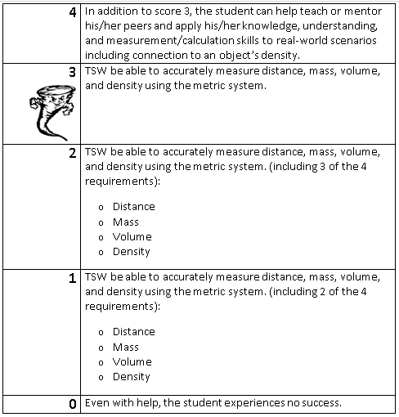
Learning Goal and Scale
TSW be able to describe how the Earth is connected to and affected by other objects in the solar system (including its movement, its relative position to other objects, its seasons, and visible constellations).

